Slide 1

SUBJECT:
Advance Java Technology
TOPIC:
Swing &
Event Handling
GUI
Swing &
Event Handling
This work is licensed under a Creative Commons Attribution-NonCommercial-ShareAlike 4.0 International License. You are free to use, distribute and modify it, for noncommercial purposes only, provided you acknowledge the source.

Slide 2
OUTLINE
Swing features
Swing Containers:
JFrame
JPanel
JWindow
Swing Components:
JLabel
ImageIcon
JTextField
JButton
JToggleButton
JCheckBox
JRadioButton
JTabbedPane
JScrollPane
JList
JComboBox
JTree
JTable
Layout managers
Event model in Java
Event classes
Event listeners
Adapter classes

Slide 3
Java Swing is a part of Java Foundation Classes (JFC) that is used to create window-based applications.
Built on the top of AWT (Abstract Windowing Toolkit) API and entirely written in java.
Unlike AWT, Java Swing provides platform-independent and lightweight components.
The javax.swing package provides classes for java swing API
JButton
JTextField
JTextArea
JRadioButton
JCheckbox
JMenu
JColorChooser etc.

Slide 4
Sr. No. | Java AWT | Java Swing
1) | AWT components are platform-dependent. | Java swing components are platform-independent.
2) | AWT components are heavyweight. | Swing components are lightweight.
3) | AWT doesn't support pluggable look and feel. | Swing supports pluggable look and feel.
4) | AWT provides less components than Swing. | Swing provides more powerful components such as tables, lists, scrollpanes, colorchooser, tabbedpane etc.
5) | AWT doesn't follows MVC (Model View Controller) where model represents data, view represents presentation and controller acts as an interface between model and view. | Swing follows MVC.

Slide 5
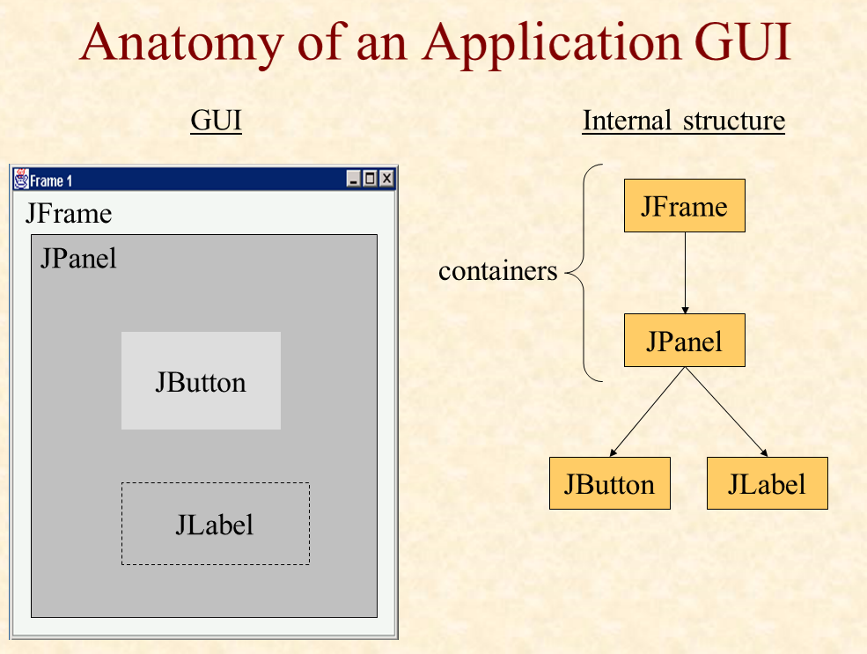

Slide 6
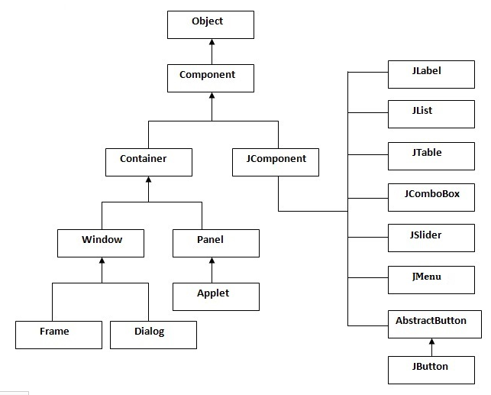
Hierarchy of Java swing API

Slide 7
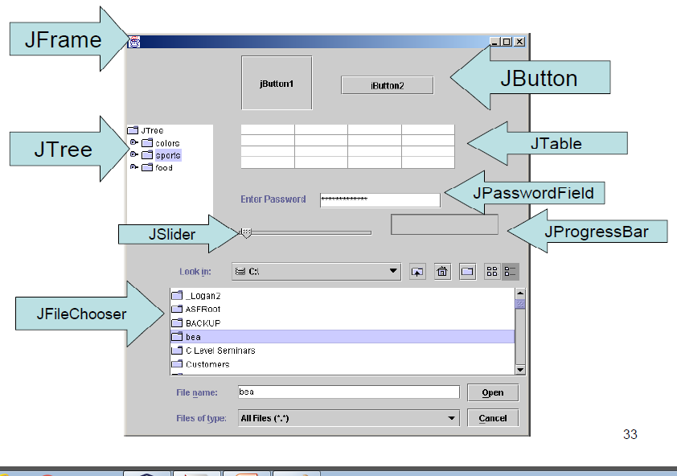

Slide 8
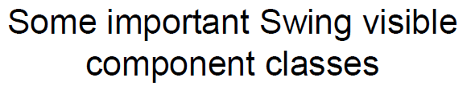
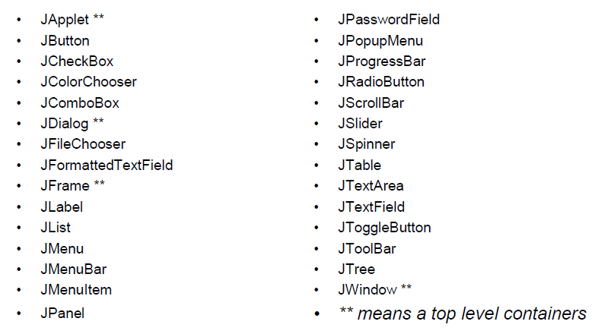

Slide 9
Commonly used Methods of Component class
Method | Description
public void add(Component c) | add a component on another component.
public void setSize (int width, int height) | sets size of the component.
public void setLayout (LayoutManager m) | sets the layout manager for the component.
public void setVisible(boolean b) | sets the visibility of the component. It is by default false.

Slide 10
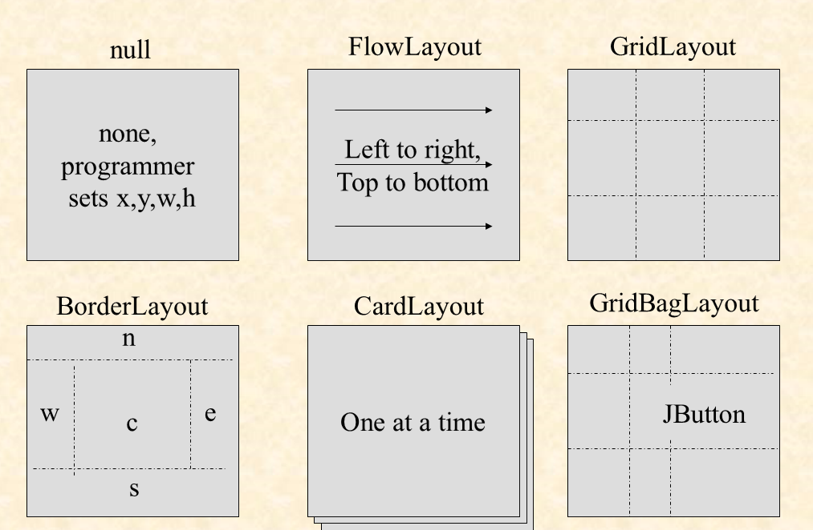
Layout Manager

Slide 11
Two ways to create a frame
By creating the object of Frame class (association)
By extending Frame class (inheritance)

Slide 12
Sample Example of Swing
package swingexample01;
import javax.swing.*;
public class SwingExample01 {
public static void main(String[] args)
{
JFrame f=new JFrame();//creating instance of JFrame
JButton b=new JButton("click");//creating instance of JButton
b.setBounds(130,100,100, 40);//x axis, y axis, width, height
f.add(b);//adding button in JFrame
f.setSize(400,500);//400 width and 500 height
f.setLayout(null);//using no layout managers
f.setVisible(true);//making the frame visible
}

Slide 13
Sample Example of Swing by Association inside constructor
import javax.swing.*;
public class Simple {
JFrame f;
Simple(){
f=new JFrame();//creating instance of JFrame
JButton b=new JButton("click");//creating instance of JButton
b.setBounds(130,100,100, 40);
f.add(b);//adding button in JFrame
f.setSize(400,500);//400 width and 500 height
f.setLayout(null);//using no layout managers
f.setVisible(true);//making the frame visible
}
public static void main(String[] args) {
new Simple();
}
}

Slide 14
Sample example of Swing by inheritance
import javax.swing.*;
public class Simple2 extends JFrame{//inheriting JFrame
Simple2(){
JButton b=new JButton("click");//create button
b.setBounds(130,100,100, 40);
add(b);//adding button on frame
setSize(400,500);
setLayout(null);
setVisible(true);
}
public static void main(String[] args) {
new Simple2();
}}

Slide 15
import javax.swing.*;
public class Simple {
JFrame f;
Simple(){
f=new JFrame();//creating instance of JFrame
JButton b=new JButton("click");
b.setBounds(130,100,100, 40);
f.add(b);//adding button in JFrame
f.setSize(400,500);//400 width and 500 height
f.setLayout(null);//using no layout managers
f.setVisible(true);//making the frame visible
}
public static void main(String[] args) {
new Simple();
}
}
import javax.swing.*;
public class Simple2 extends Jframe{
Simple2(){
JButton b=new JButton("click");//create button
b.setBounds(130,100,100, 40);
add(b);//adding button on frame
setSize(400,500);
setLayout(null);
setVisible(true);
}
public static void main(String[] args) {
new Simple2();
}
}

Slide 16
Sample example of JButton
import javax.swing.*;
public class ButtonExample {
public static void main(String[] args) {
JFrame f=new JFrame("Button Example");
JButton b=new JButton("Click Here");
b.setBounds(50,100,95,30);
f.add(b);
f.setSize(400,400);
f.setLayout(null);
f.setVisible(true);
}
}

Slide 17
Sample example of JButton with Action Listener
import java.awt.event.*;
import javax.swing.*;
public class ButtonExample {
public static void main(String[] args) {
JFrame f=new JFrame("Button Example");
final JTextField tf=new JTextField();
tf.setBounds(50,50, 150,20);
JButton b=new JButton("Click Here");
b.setBounds(50,100,95,30);
b.addActionListener(new ActionListener(){
public void actionPerformed(ActionEvent e){
tf.setText("Welcome Swing.");
}
});
f.add(b);f.add(tf);
f.setSize(400,400);
f.setLayout(null);
f.setVisible(true);
}
}
Note: Checkout more JButton examples here.

Slide 18
JLabel Example
import javax.swing.*;
class LabelExample {
public static void main(String args[]) {
JFrame f= new JFrame("Label Example");
JLabel l1,l2;
l1=new JLabel("First Label.");
l1.setBounds(50,50, 100,30);
l2=new JLabel("Second Label.");
l2.setBounds(50,100, 100,30);
f.add(l1); f.add(l2);
f.setSize(300,300);
f.setLayout(null);
f.setVisible(true);
}
}
Note: Checkout more JLabel examples here.

Slide 19
Sample example Radio button
import javax.swing.*;
Class RadioButtonexample{
public static void main(String[] args) {
JFrame f=new JFrame();
JRadioButton r1=new JRadioButton("Male");
JRadioButton r2=new JRadioButton("Female");
r1.setBounds(50,100,70,30);
r2.setBounds(50,150,70,30);
ButtonGroup bg=new ButtonGroup();
bg.add(r1);
bg.add(r2);
f.add(r1);
f.add(r2);
f.setSize(300,300);
f.setLayout(null);
f.setVisible(true);
} } }
ButtonGroup class can be used to group multiple buttons so that at a time only one button can be selected.

Slide 20
Sample example Radio button with Action Listener
import javax.swing.*;
import java.awt.event.*;
class RadioExample extends JFrame
implements ActionListener{
JRadioButton rb1,rb2;
JButton b;
RadioExample(){
rb1=new JRadioButton("Male");
rb1.setBounds(100,50,100,30);
rb2=new JRadioButton("Female");
rb2.setBounds(100,100,100,30);
ButtonGroup bg=new ButtonGroup();
bg.add(rb1);
bg.add(rb2);
b=new JButton("click");
b.setBounds(100,150,80,30);
b.addActionListener(this);
add(rb1);add(rb2);add(b);
setSize(300,300);
setLayout(null);
setVisible(true);
}
public void actionPerformed(ActionEvent e){
if(rb1.isSelected()){
JOptionPane.showMessageDialog(this,
"You are male");
}
else{
JOptionPane.showMessageDialog(this, "You are female");
}
}
public static void main(String args[]){
new RadioExample();
}}

Slide 21
import javax.swing.*;
import java.awt.event.*;
class RadioExample extends JFrame
implements ActionListener{
JRadioButton rb1,rb2;
JButton b;
public static void main(String args[]){
rb1=new JRadioButton("Male");
rb1.setBounds(100,50,100,30);
rb2=new JRadioButton("Female");
rb2.setBounds(100,100,100,30);
ButtonGroup bg=new ButtonGroup();
bg.add(rb1);
bg.add(rb2);
b=new JButton("click");
b.setBounds(100,150,80,30);
b.addActionListener(this);
add(rb1);add(rb2);add(b);
setSize(300,300);
setLayout(null);
setVisible(true);
}
public void actionPerformed(ActionEvent e)
{
if(rb1.isSelected()){
JOptionPane.showMessageDialog(this,
"You are male");
}
else{
JOptionPane.showMessageDialog(this,"You are female");
}
}
}}

Slide 22
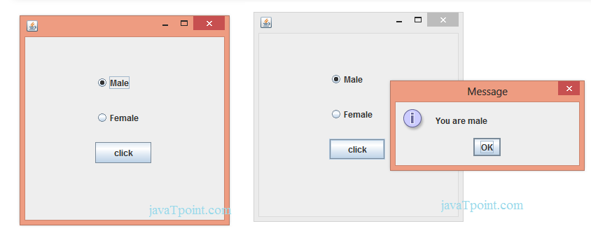

Slide 23
JTextField
The object of a JTextField class is a text component that allows the editing of a single line text. It inherits JTextComponent class.
JTextField class declaration
public class JTextField extends JTextComponent implements SwingConstants
Constructor | Description
JTextField() | Creates a new TextField
JTextField(String text) | Creates a new TextField initialized with the specified text.
JTextField(String text, int columns) | Creates a new TextField initialized with the specified text and columns.
JTextField(int columns) | Creates a new empty TextField with the specified number of columns.

Slide 24
JTextField Methods
Methods | Description
void addActionListener (ActionListener l) | It is used to add the specified action listener to receive action events from this textfield.
Action getAction() | It returns the currently set Action for this ActionEvent source, or null if no Action is set.
void setFont(Font f) | It is used to set the current font.
void removeActionListener (ActionListener l) | It is used to remove the specified action listener so that it no longer receives action events from this textfield.

Slide 25
JTextField Example
import javax.swing.*;
class TextFieldExample {
public static void main(String args[]) {
JFrame f= new JFrame("TextField Example");
JTextField t1,t2;
t1=new JTextField("Welcome to Swing.");
t1.setBounds(50,100, 200,30);
t2=new JTextField("AWT Tutorial");
t2.setBounds(50,150, 200,30);
f.add(t1); f.add(t2);
f.setSize(400,400);
f.setLayout(null);
f.setVisible(true);
}
}
Note: Checkout more JTextField examples here.

Slide 26
Commonly used Constructors
JTextArea(): creates a text area that displays no text initially.
JTextArea(String s): creates a text area that displays specified text initially.
JTextArea(int row, int column): creates a text area with the specified number of rows and columns that displays no text initially..
JTextArea(String s, int row, int column): creates a text area with the specified number of rows and columns that displays specified text.

Slide 27
Commonly used methods of JTextArea class:
1)public void setRows(int rows): is used to set specified number of rows.
2) public void setColumns(int cols):: is used to set specified number of columns.
3) public void setFont(Font f): is used to set the specified font.
4) public void insert(String s, int position): is used to insert the specified text on the specified position.
5) public void append(String s): is used to append the given text to the end of the document.

Slide 28
import java.awt.Color;
import javax.swing.*;
Class AREA1{
public static void main(String[] args) {
JFrame f=new JFrame();
JTextArea area=new JTextArea(300,300);
area.setBounds(10,30,300,300);
area.setBackground(Color.black);
area.setForeground(Color.white);
f.add(area);
f.setSize(400,400);
f.setLayout(null);
f.setVisible(true);
} }

Slide 29
import java.awt.Color;
import javax.swing.*;
Class AREA1 extends JFrame{
public static void main(String[] args) {
JTextArea area=new JTextArea(300,300);
area.setBounds(10,30,300,300);
area.setBackground(Color.black);
area.setForeground(Color.white);
add(area);
setSize(400,400);
setLayout(null);
setVisible(true);
} }

Slide 30
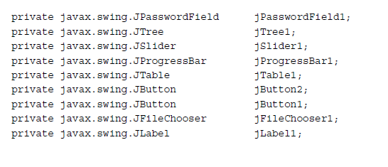

Slide 31
Commonly used methods of JComboBox class:
1) public void addItem(Object anObject): is used to add an item to the item list.
2) public void removeItem(Object anObject): is used to delete an item to the item list.
3) public void removeAllItems(): is used to remove all the items from the list.
4) public void setEditable(boolean b): is used to determine whether the JComboBox is editable.
5) public void addActionListener(ActionListener a): is used to add the ActionListener.
6) public void addItemListener(ItemListener i): is used to add the ItemListener.

Slide 32
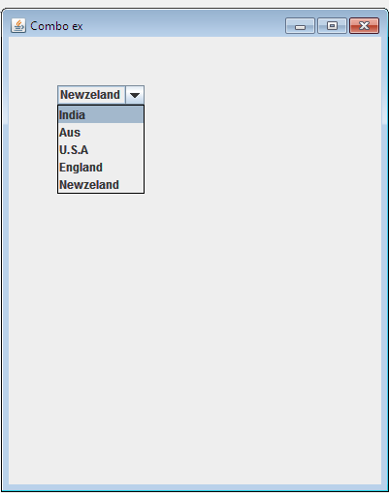

Slide 33
import javax.swing.*;
public class Combo {
public static void main(String[] args) {
JFrame f=new JFrame("Combo ex");
String country[]={"India","Aus","U.S.A","England","Newzeland"};
JComboBox cb=new JComboBox(country);
cb.setBounds(50, 50,90,20);
f.add(cb);
f.setLayout(null);
f.setSize(400,500);
f.setVisible(true);
}
}

Slide 34
Commonly used Constructors of JTable class
JTable(): creates a table with empty cells.
JTable(Object[][] rows, Object[] columns): creates a table with the specified data.

Slide 35
import javax.swing.*;
public class MyTable {
public static void main(String[] args) {
JFrame f=new JFrame();
String data[][]={ {"101","Amit","670000"},
{"102","Jai","780000"},
{"101","Sachin","700000"}};
String column[]={"ID","NAME","SALARY"};
JTable jt=new JTable(data,column);
jt.setBounds(30,40,200,300);
JScrollPane sp=new JScrollPane(jt);
f.add(sp);
f.setSize(300,400);
// f.setLayout(null);
f.setVisible(true);
}
}

Slide 36
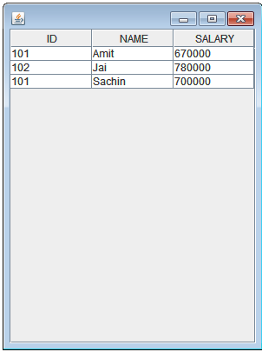

Slide 37
Slider Constructors
Constructor | Description
JSlider() | creates a slider with the initial value of 50 and range of 0 to 100.
JSlider(int orientation) | creates a slider with the specified orientation set by either JSlider.HORIZONTAL or JSlider.VERTICAL with the range 0 to 100 and initial value 50.
JSlider(int min, int max) | creates a horizontal slider using the given min and max.
JSlider(int min, int max, int value) | creates a horizontal slider using the given min, max and value.
JSlider(int orientation, int min, int max, int value) | creates a slider using the given orientation, min, max and value.

Slide 38
Method | Description
public void setMinorTickSpacing(int n) | is used to set the minor tick spacing to the slider.
public void setMajorTickSpacing(int n) | is used to set the major tick spacing to the slider.
public void setPaintTicks(boolean b) | is used to determine whether tick marks are painted.
public void setPaintLabels(boolean b) | is used to determine whether labels are painted.
public void setPaintTracks(boolean b) | is used to determine whether track is painted.

Slide 39
import javax.swing.*;
public class SliderExample extends JFrame{
public static void main(String s[]) {
JSlider slider = new JSlider(JSlider.HORIZONTAL, 0, 50, 25);
slider.setMinorTickSpacing(2);
slider.setMajorTickSpacing(10);
slider.setPaintTicks(true);
slider.setPaintLabels(true);
JPanel panel=new JPanel();
panel.add(slider);
add(panel);
setVisible(true);
}
}

Slide 40
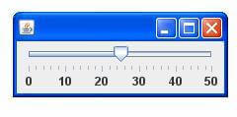

Slide 41
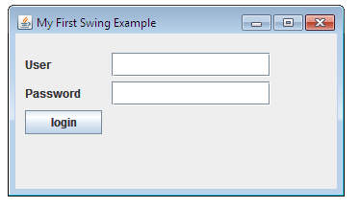

Slide 42
import javax.swing.*
public class SwingFirstExample {
public static void main(String[] args) {
JFrame frame = new JFrame("My First Swing Example");
frame.setSize(350, 200);
JPanel panel = new JPanel();
frame.add(panel);
panel.setLayout(null);
JLabel userLabel = new JLabel("User");
userLabel.setBounds(10,20,80,25);
panel.add(userLabel);
JTextField userText = new JTextField( 20);
userText.setBounds(100,20,165,25);
panel.add(userText);
JLabel passwordLabel = new JLabel("Password");
passwordLabel.setBounds(10,50,80,25);
panel.add(passwordLabel);
JPasswordField passwordText = new JPasswordField(20);
passwordText.setBounds(100,50,165,25);
panel.add(passwordText);
JButton loginButton = new JButton("login");
loginButton.setBounds(10, 80, 80, 25);
panel.add(loginButton);
frame.setVisible(true);
}
}
}

Slide 43
Constructor | Description
JTree() | Creates a JTree with a sample model.
JTree(Object[] value) | Creates a JTree with every element of the specified array as the child of a new root node.
JTree(TreeNode root) | Creates a JTree with the specified TreeNode as its root, which displays the root node.

Slide 44
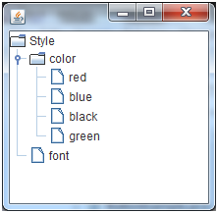

Slide 45
import javax.swing.*;
import javax.swing.tree.DefaultMutableTreeNode;
public class TreeExample {
JFrame f=new JFrame();
public static void main(String[] args) {
DefaultMutableTreeNode style=new DefaultMutableTreeNode("Style");
DefaultMutableTreeNode color=new DefaultMutableTreeNode("color");
DefaultMutableTreeNode font=new DefaultMutableTreeNode("font");
style.add(color);
style.add(font);
DefaultMutableTreeNode red=new DefaultMutableTreeNode("red");
DefaultMutableTreeNode blue=new DefaultMutableTreeNode("blue");
DefaultMutableTreeNode black=new DefaultMutableTreeNode("black");
DefaultMutableTreeNode green=new DefaultMutableTreeNode("green");
color.add(red);
color.add(blue);
color.add(black);
color.add(green);
JTree jt=new JTree(style);
f.add(jt);
f.setSize(200,200);
f.setVisible(true);
}

Slide 46
Constructor | Description
JTabbedPane() | Creates an empty TabbedPane with a default tab placement of JTabbedPane.Top.
JTabbedPane(int tabPlacement) | Creates an empty TabbedPane with a specified tab placement.
JTabbedPane(int tabPlacement, int tabLayoutPolicy) | Creates an empty TabbedPane with a specified tab placement and tab layout policy.

Slide 47
import javax.swing.*;
public class TabbedPaneExample {
JFrame f=new JFrame();
public static void main(String[] args) {
JTextArea ta=new JTextArea(200,200);
JPanel p1=new JPanel();
p1.add(ta);
JPanel p2=new JPanel();
JPanel p3=new JPanel();
JTabbedPane tp=new JTabbedPane();
tp.setBounds(50,50,200,200);
tp.add("main",p1);
tp.add("visit",p2);
tp.add("help",p3);
f.add(tp);
f.setSize(400,400);
f.setLayout(null);
f.setVisible(true);
} }

Slide 48
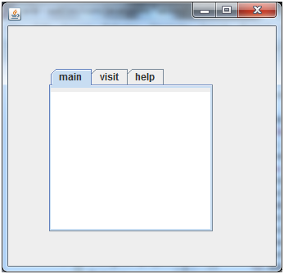

Slide 49
Constructor | Description
JList() | Creates a JList with an empty, read-only, model.
JList(ary[] listData) | Creates a JList that displays the elements in the specified array.
JList(ListModel<ary> dataModel) | Creates a JList that displays elements from the specified, non-null, model.

Slide 50
Methods | Description
void addListSelectionListener (ListSelectionListener listener) | It is used to add a listener to the list, to be notified each time a change to the selection occurs.
int getSelectedIndex() | It is used to return the smallest selected cell index.
ListModel getModel() | It is used to return the data model that holds a list of items displayed by the JList component.
void setListData(Object[] listData) | It is used to create a read-only ListModel from an array of objects.

Slide 51
import javax.swing.*;
public class ListExample
{
JFrame f= new JFrame();
public static void main(String args[])
{
DefaultListModel<String> l1 = new DefaultListModel<>();
l1.addElement("Item1");
l1.addElement("Item2");
l1.addElement("Item3");
l1.addElement("Item4");
JList<String> list = new JList<>(l1);
list.setBounds(100,100, 75,75);
f.add(list);
f.setSize(400,400);
f.setLayout(null);
f.setVisible(true);
}

Slide 52
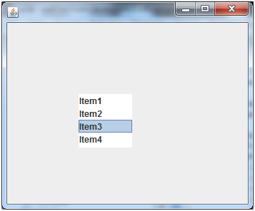

Slide 53
JLabel label = new JLabel("SUBJECT ");
label.setIcon(new ImageIcon("E:\\new.png"));
JTextArea text = new JTextArea();
text.setText("Add subject here...");

Slide 54
package my;
import java.awt.GridBagLayout;
import javax.swing.*
import javax.swing.WindowConstants;
public class SwingDemo {
public static void main(String[] args) {
JFrame frame = new JFrame("Demo Frame");
JPanel panel = new JPanel();
JLabel label = new JLabel("SUBJECT ");
label.setIcon(new ImageIcon("E:\\new.png"));
JTextArea text = new JTextArea();
text.setText("Add subject here...");
panel.setLayout(new GridBagLayout());
panel.add(label);
panel.add(text);
panel.setBorder(BorderFactory.createEmptyBorder(10, 10, 10, 10));
frame.setDefaultCloseOperation(WindowConstants.EXIT_ON_CLOSE);
frame.add(panel);
frame.setSize(500, 300);
frame.setVisible(true);
}
}

Slide 55
setDefaultCloseOperation(javax.swing.WindowConstants.EXIT_ON_CLOSE);

Slide 56
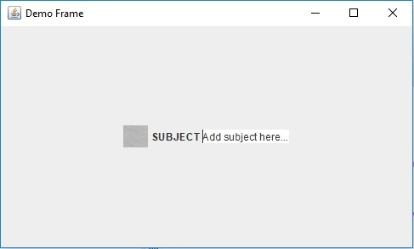

Slide 57
Model–view–controller (MVC)
Model–view–controller (MVC) is a software architectural pattern for implementing user interfaces on computers.
it divides a given software application into three interconnected parts, so as to separate internal representations of information from the ways that information is presented to or accepted from the user.

Slide 58
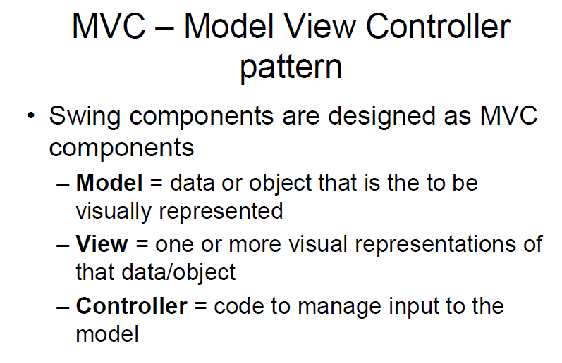

Slide 59
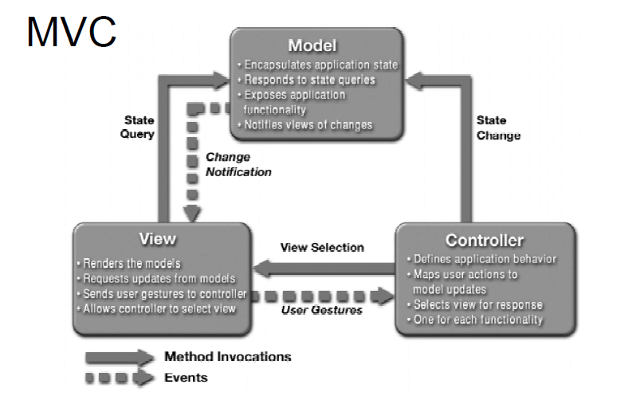
`````````````````````````````

Slide 60
Layout Managers
Facilitates us to control the positioning and size of the components in GUI forms.
An interface that is implemented by all the classes of layout managers.
java.awt.BorderLayout
java.awt.FlowLayout
java.awt.GridLayout
java.awt.CardLayout
java.awt.GridBagLayout
javax.swing.BoxLayout
javax.swing.GroupLayout
javax.swing.ScrollPaneLayout
javax.swing.SpringLayout etc.

Slide 61
BorderLayout
To arrange the components in five regions:
north, south, east, west, and center.
Each region (area) may contain one component only.
It is the default layout of a frame or window.
The BorderLayout provides five constants for each region:
public static final int NORTH
public static final int SOUTH
public static final int EAST
public static final int WEST
public static final int CENTER

Slide 62
Constructors
BorderLayout(): creates a border layout but with no gaps between the components.
BorderLayout(int hgap, int vgap): creates a border layout with the given horizontal and vertical gaps between the components.

